Slide 1

Pratical Project Robotic hand grasping and lifting objects
Group: 5
Supervisor: Abdeldjallil Naceri
Tutor: Zhelin Yang
16.07.2024

Slide 2
Agenda
1. Robotic Hands and Scenes
Wonik - Allegro Hand
Medium Wrap
2. PID Position Control
3. Impedance Control
4. Challenge
5. Literature sources

Slide 3
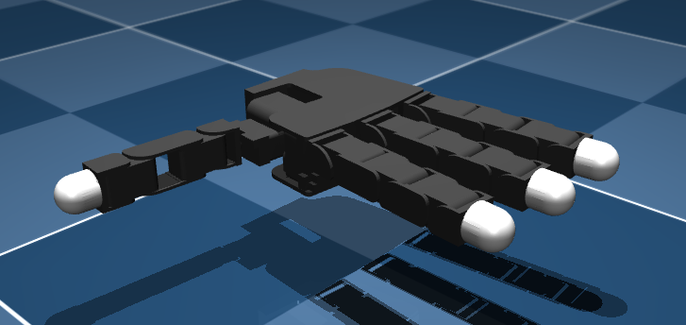
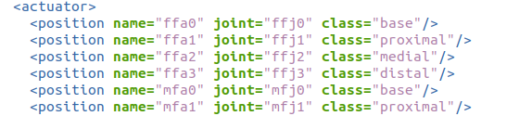
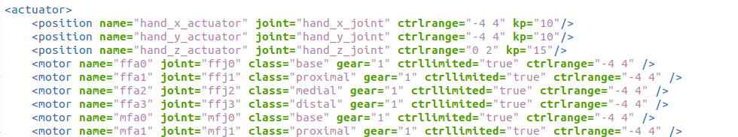
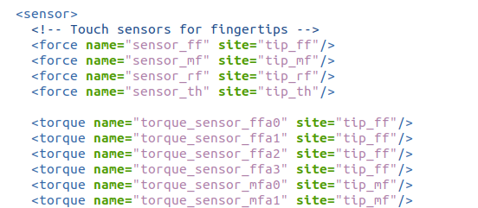
Robotic Hands
Wonik - Allegro Hand
Multiple degrees of freedom
4 fingers, each with 4 joints, 16 DOF
Fully driven by high precision servo motors
Integrated Sensors
allegro right hand

Slide 4
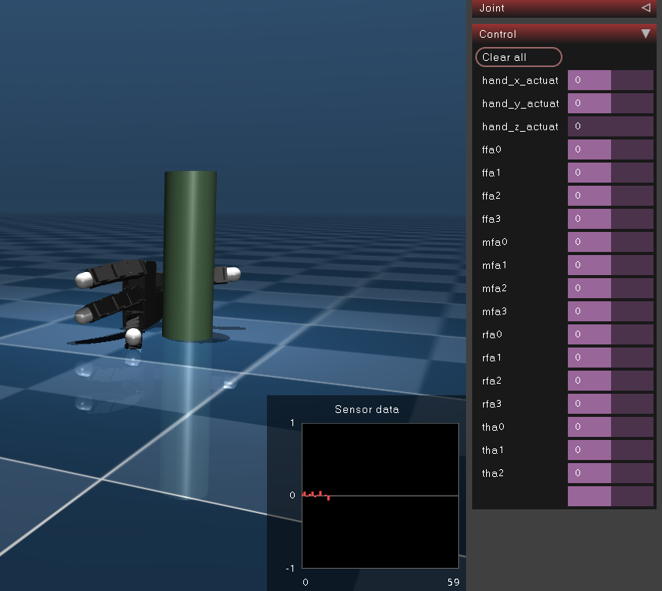
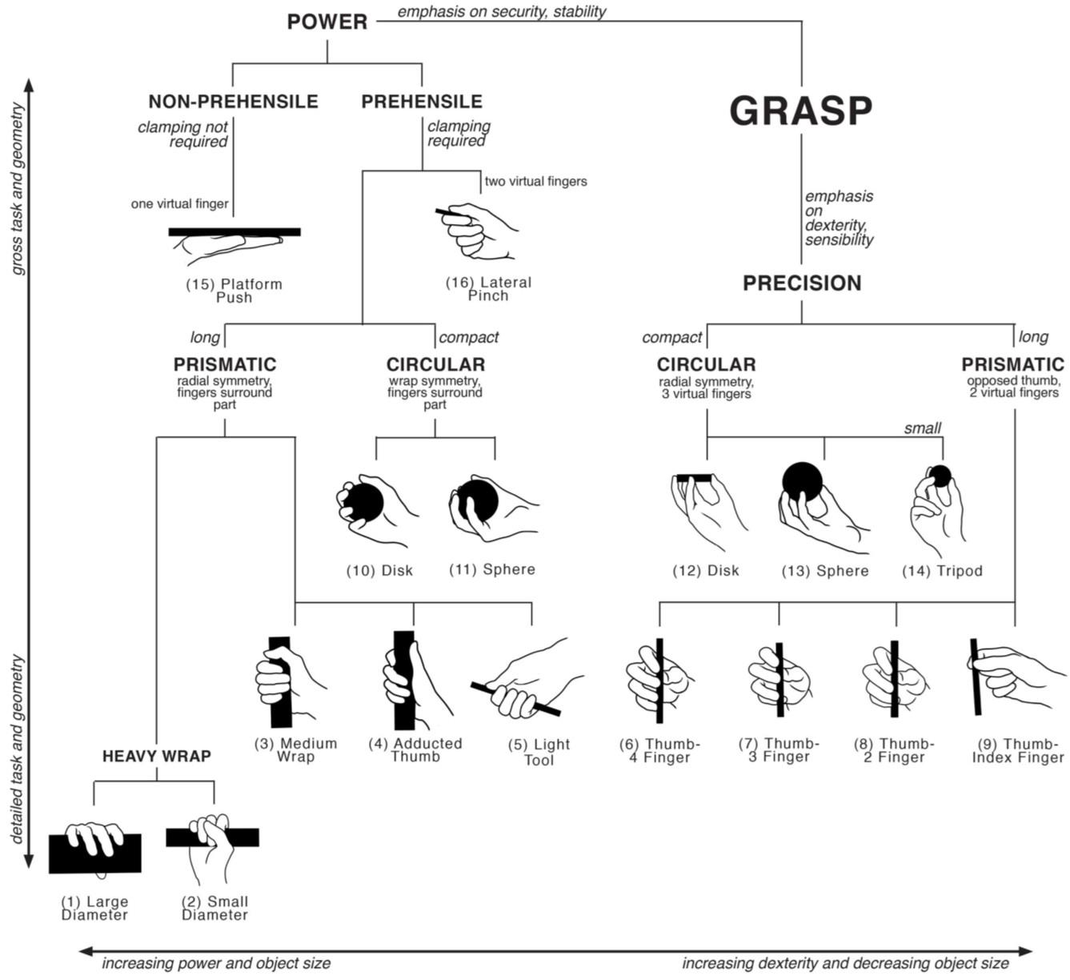
Grasp methods and objects
Grasping objects
1.3 kg cylinder
Grasping mode
Medium wrap
Contact model
Hard finger contact
Scenes of gripping tasks with uncontrolled hand

Slide 5
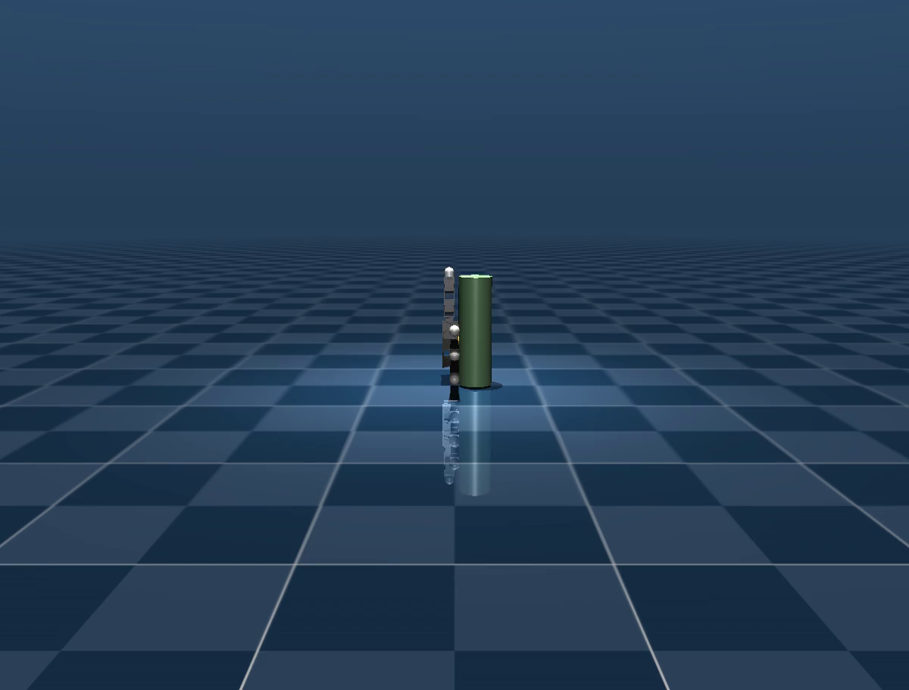
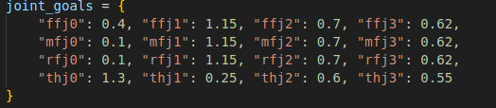
PID Position Control
Predefined joint angles
Finger grip
Lifting
Predefined target joint angles
Process of grasping and lifting by PID position controller

Slide 6
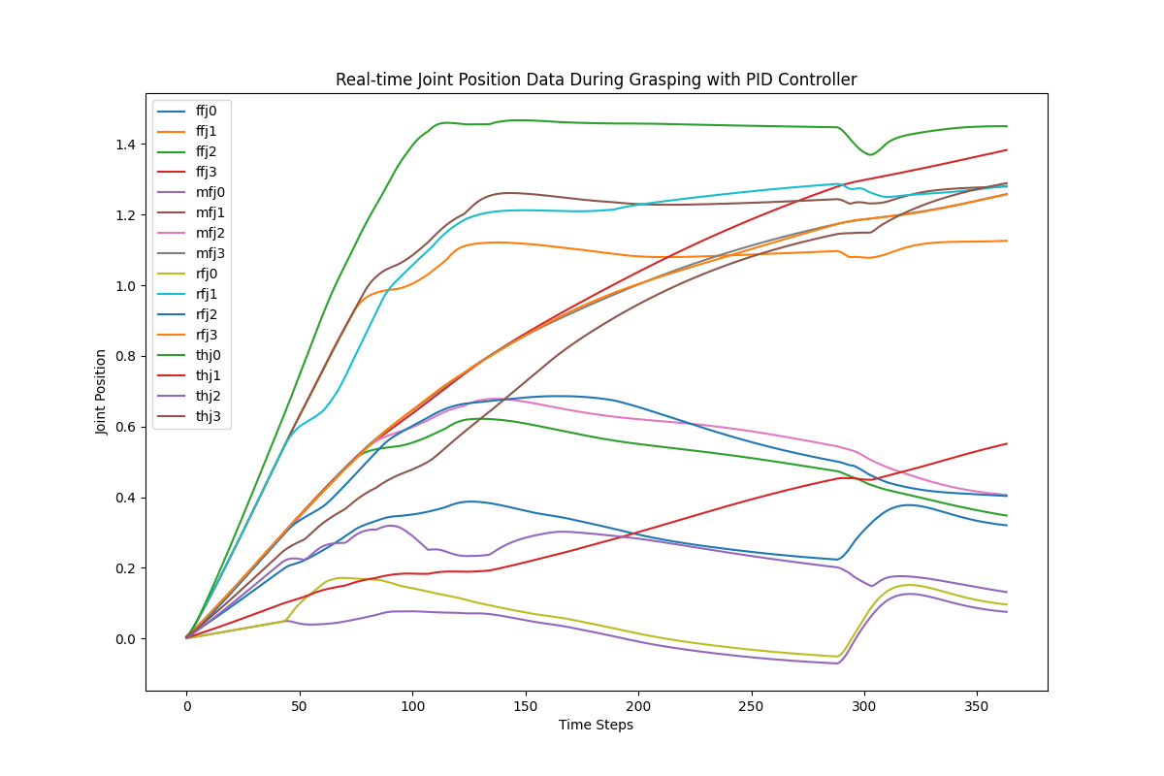
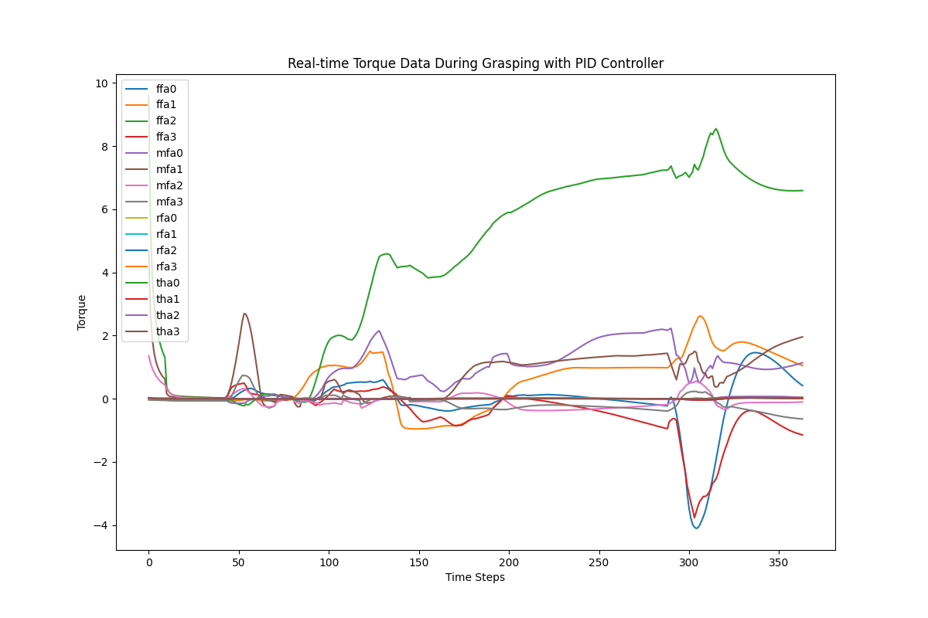
Analysis of real-time position and torque
Large gap between target and actual joint angles for preset joint angles
High torque fluctuations - well outside the -4 to 4 joint torque range
What if the object is an expensive glass?

Slide 7
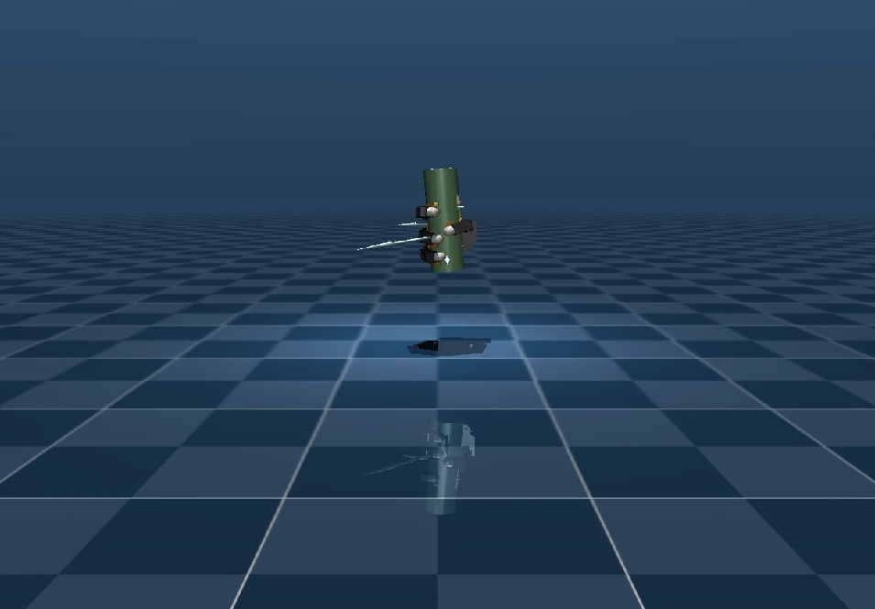
Impedance Control (Torque-Based)
Stiffness,Ks
Strength of control system response to position error
​Damping,B
Strength of control system response to speed errors
Mass,M
Modelling the inertia of the system
Process of grasping and lifting by Impedance controller

Slide 8
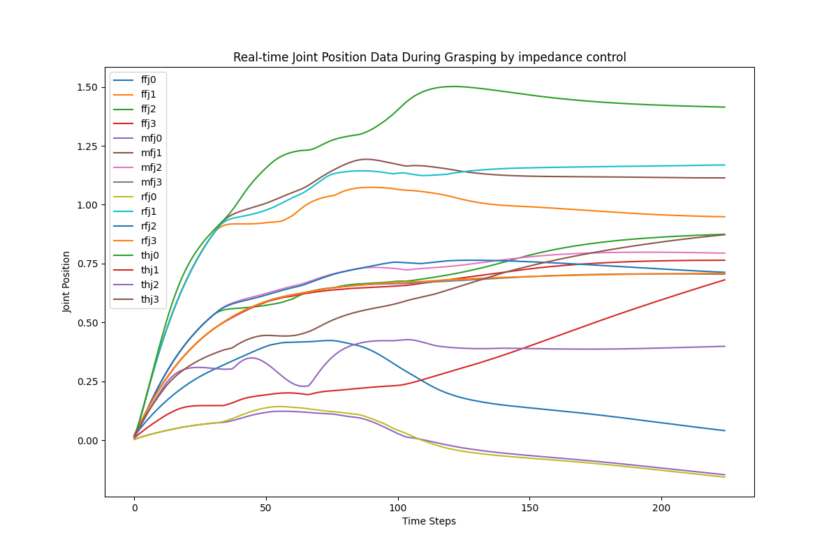
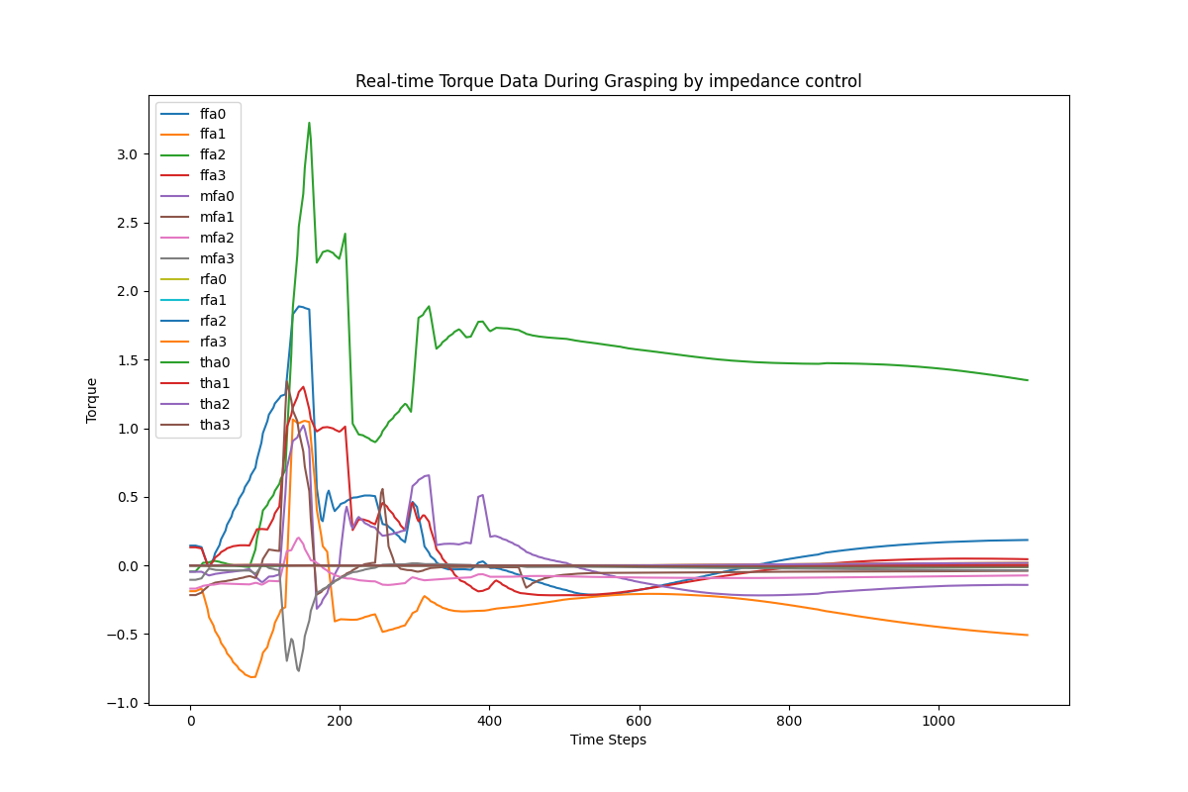
Analysis of real-time position and torque
Small and smooth fluctuations in joint position
Flexibility and stability of torque

Slide 9
Challenge
Optimising control algorithms
Adding industrial robot forearms
Perform different types of grasping tasks through reinforcement learning

Slide 10
Thank you for your attention.

Slide 11
Literature sources
T. Feix, I. M. Bullock and A. M. Dollar, "Analysis of Human Grasping Behavior: Object Characteristics and Grasp Type," in IEEE Transactions on Haptics, vol. 7, no. 3, pp. 311-323, 1 July-Sept. 2014, doi: 10.1109/TOH.2014.2326871.
A. Naceri et al., "Tactile Robotic Telemedicine for Safe Remote Diagnostics in Times of Corona: System Design, Feasibility and Usability Study," in IEEE Robotics and Automation Letters, vol. 7, no. 4, pp. 10296-10303, Oct. 2022, doi: 10.1109/LRA.2022.3191563.
https://mujoco.readthedocs.io/en/stable/overview.html
GitHub - google-deepmind/mujoco_menagerie: A collection of high-quality models for the MuJoCo physics engine, curated by Google DeepMind.

